Slide 1
DANA 4840
Classification II
Part IV Cluster Validation Statistics
Part 3 – Connectivity

Slide 2
Connectivity
Recap: We learnt in previous classes that clusters should be c________ and w_____-s_________________. [Hence the use of Dunn Index as a cluster validation technique.]
In addition, you will learn today that clusters should also be connected and stable.

Slide 3
Connectedness / Connectivity
Connectedness (measured by connectivity) corresponds to what extent items are placed in the same cluster as their nearest neighbours in the data space.
Close neighbours that are put in different clusters are penalized.
Important: Smallest value of Connectivity is 0. You will see why when you understand how connectivity is calculated.

Slide 4
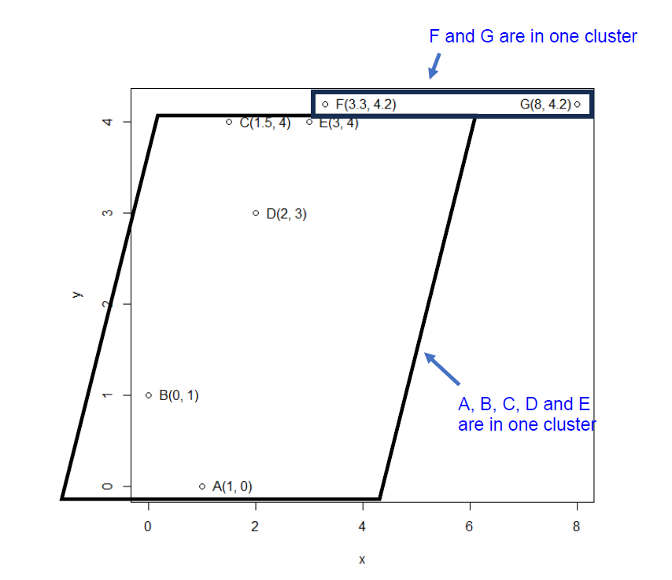
How to calculate Connectivty?
As an example:
Use number of neighbours to be 2 to calculate the Connectivity of the data set drawn.

Slide 5
Practice question
Calculate Connectivity for the same data set using number of nearest neighbours = 3.

Slide 6
R code:
You can obtain connectivity scores using clValid package (thick document that is handed out to you).
Command:
connectivity(distance_matrix, cluster, neighbSize = 2)
See Worksheet 20 for example of R code.

Slide 7
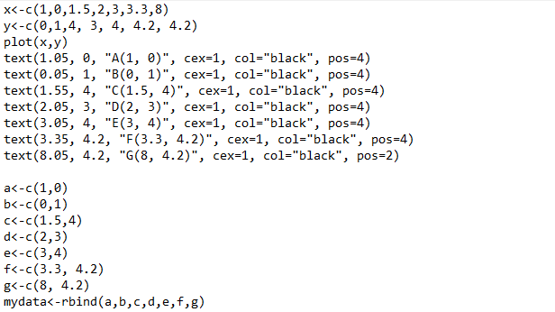
R code for exercise (continue next page)

Slide 8
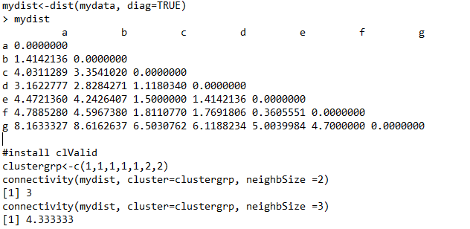
Continuation:

